Slide 1
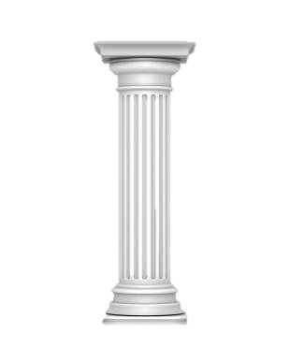
Second Year Algebra with CAS
Teaching
Learning
Assessment

Slide 2
Warm Up:
Solve a System

Slide 3
What should this title be?
Simplify:
  Combine like terms
  Reduce a fraction
  Simplify a radical
Expand:
  Distribute
  FOIL
  Binomial Theorem
Factor:
  Quadratic trinomials
  Any polynomial!
  Over the Rational, Real, or Complex Numbers
Solve Exactly:
  Linear Equations
  Quadratic Equations
  Systems of Equations
  Polynomial, Radical, Exponential, Logarithmic, Trigonometric Equations
Solve Numerically:
  Any equation you can write
Solve Formulas for any variable
Teaching

Slide 4
A Deliberately Provocative Statement
“If algebra is useful only for finding roots of equations, slopes, tangents, intercepts, maxima, minima, or solutions to systems of equations in two variables, then it has been rendered totally obsolete by cheap, handheld graphing calculators -- dead -- not worth valuable school time that might instead be devoted to art, music, Shakespeare, or science.”
-- E. Paul Goldenberg
Computer Algebra Systems in Secondary Mathematics Education
Teaching

Slide 5
Learning How to Learn
In a world that is constantly changing, what skills do students need?
  Apply their knowledge
  Generalize
  Recognize situations and the tools they have to address them
Learning

Slide 6
What We Teach
The “Real World”
Algebra
Problem Situation
Algebraic Model
Teaching
Interpretation
Solution
Kutzler, B. (2001). What Math Should We Teach When We Teach Math With CAS? http://b.kutzler.com/downloads/what_math_should_we_teach.pdf

Slide 7
How Many Ways?
How many different ways can you solve:
7^{x} = 57
Teaching

Slide 8
Warm Up:
Solve a System
Learning
(-1, 2)
(-1, 2)
Coincidence?

Slide 9
Generalize!
Can you write another example with the same pattern?
Can you describe the pattern
  In words?
  In algebraic notation?
Can you solve the general situation?
Learning

Slide 10
Generalize!
What next?
Do you have to add one each time, or will any arithmetic sequence work for the coefficients?
Do the two sequences of coefficients have to have the same difference?
What about a geometric sequence?
Learning

Slide 11
CAS as an Experimental Tool
Evaluate with CAS:
  ln(5) + ln(2)
  ln(3) + ln(7)
  ln(10) + ln(3/5)
  ln(1/3) + ln(2/5)
Make a prediction. Test it.
Write the general rule.
Expand: subtraction? Scalar multiplication?.
Learning

Slide 12
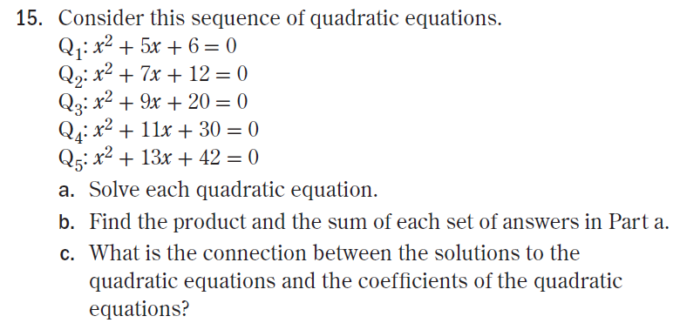
Generalize
Learning
UCSMP Advanced Algebra, 3rd Edition, p.418

Slide 13
Flexibility: Multiple Forms
What does each form tell you about the graph?
  y = x² – 8x + 15
  (y + 1) = (x – 4)²
  y = (x – 3)(x – 5)
Learning

Slide 14
Soapbox: On Factoring
Factor x² – 4x – 5
Factor x² – 4x + 1
Factor x² – 4x + 5
Learning

Slide 15
Flexibility: Multiple Forms
What does each form tell you?
Learning

Slide 16
Possible Impacts of CAS on Traditional Algebra 2 Questions
CAS is irrelevant
CAS makes it trivial
CAS allows alternate solutions
CAS is required for a solution
Assessment

Slide 17
Changing Traditional Questions for a CAS Environment
Require students to answer without CAS
Get more General
Require Interpretation of Answers
  (“Thinking Also Required”)
Focus on the Process rather than the Result
Turn Questions Around
Assessment

Slide 18

Paper and Pencil Questions
Important to have both specific and general questions
  Solve 4x – 3 = 8 AND Solve y = m x + b for x
  Solve x ² + 2x = 15 AND Solve a x ² + b x + c = 0
  Solve 54 = 2(1 + r)³ AND Solve A = P e ^{r t} for r
Assessment

Slide 19
Get More General
Traditional: Find the slope of a line perpendicular to the line through (3, 1) and (-2, 5).
CAS-Enabled: Find the slope of a line perpendicular to the line through (a, b) and (c, d).
Assessment

Slide 20
Get More General
Traditional: Given an arithmetic sequence a with first term 8 and common difference 2.5, find a₅ + a₈.
CAS-Enabled: Given an arithmetic sequence a with first term t and common difference d, show that
a₅ + a₈ = a₃ + a₁₀.
Assessment

Slide 21
Thinking Also Required
Solve this formula for d
The force of gravity (F) between two objects is given by the formula
where m₁ and m₂ are the masses of the two objects, d is the distance between them, and G is the universal gravitational constant.
Assessment

Slide 22
Thinking Also Required
Alexis shoots a basketball, releasing it from her hand at a height of 5.8 feet and giving it an initial upward velocity of 27 ft/s.
Traditional: At what time(s) is the ball exactly 10 feet high?
CAS-Enabled: The basket is exactly 10 feet high. To the nearest tenth of a second, how long is it before the ball swishes through the net to win the game?
Assessment

Slide 23
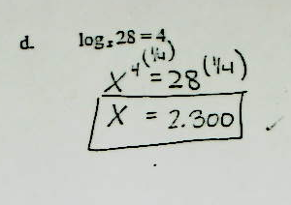
Thinking Also Required
Solve log_{x}28 = 4
Assessment

Slide 24
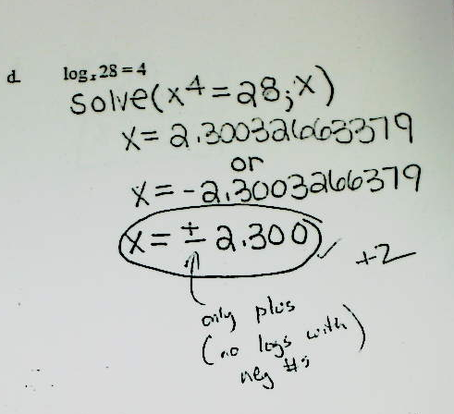
Thinking Also Required
Assessment

Slide 25

Focus on the Process
Your calculator says that
(see right).
Show the work that proves it.
Assessment

Slide 26
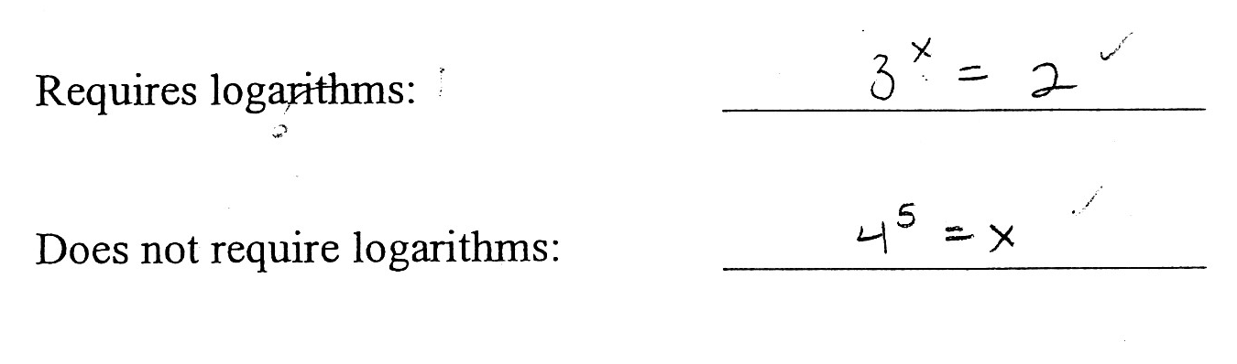
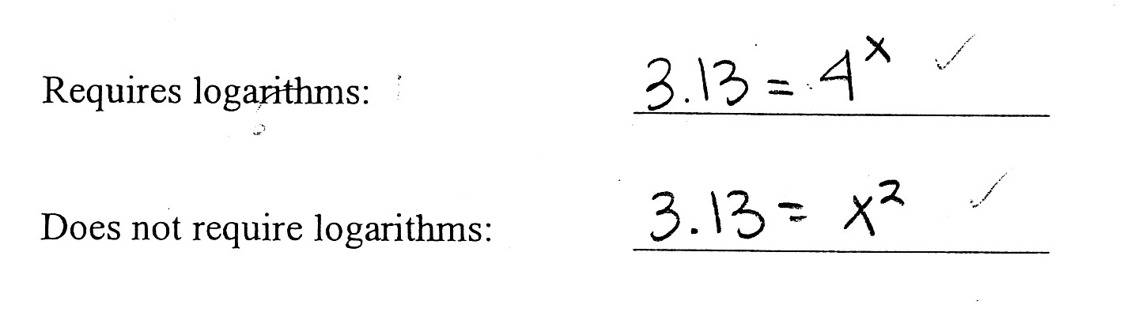
Focus on the Process
Give examples of two equations involving an exponent: one that requires logarithms to solve, and one that does not.
Assessment

Slide 27
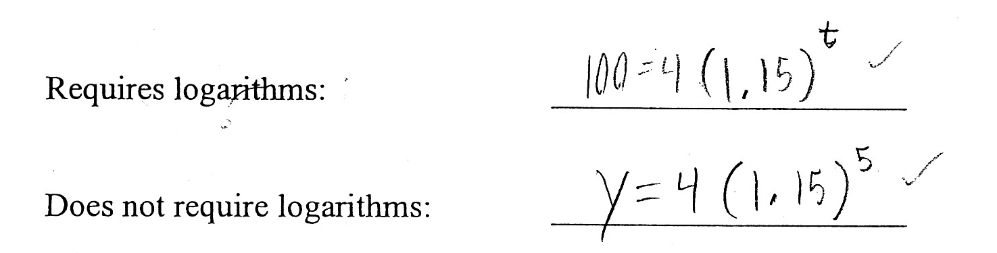
Focus on the Process
Give examples of two equations involving an exponent: one that requires logarithms to solve, and one that does not.
Assessment

Slide 28
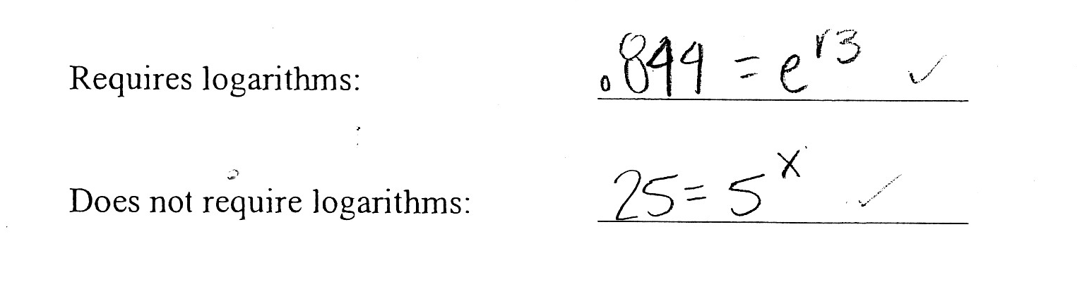
Focus on the Process
Give examples of two equations involving an exponent: one that requires logarithms to solve, and one that does not.
Assessment

Slide 29
Turn The Around
Question
Traditional: Simplify
log(4) + log(15) – log(3)
CAS-Enabled: Use the properties of logarithms to write three different expressions equal to log(20). At least one should use a sum and one should use a difference.
Assessment

Slide 30
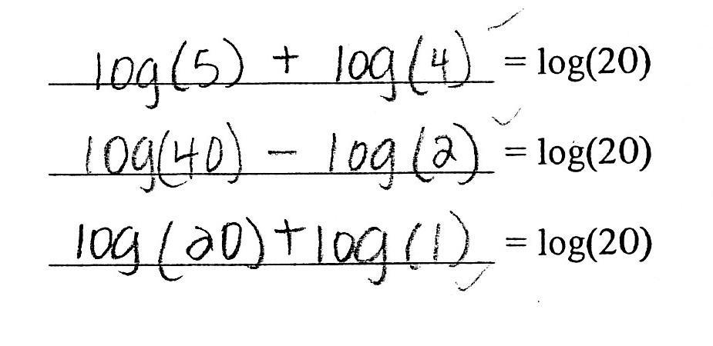
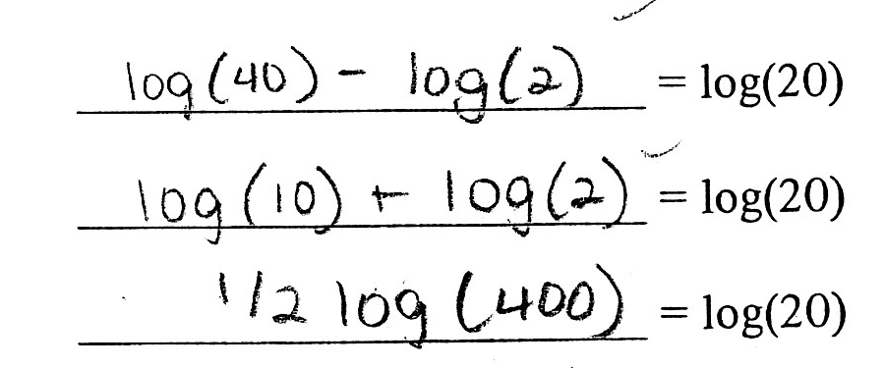
Use the properties of logarithms to write three different expressions equal to log(20). At least one should use a sum and one should use a difference.
Assessment

Slide 31
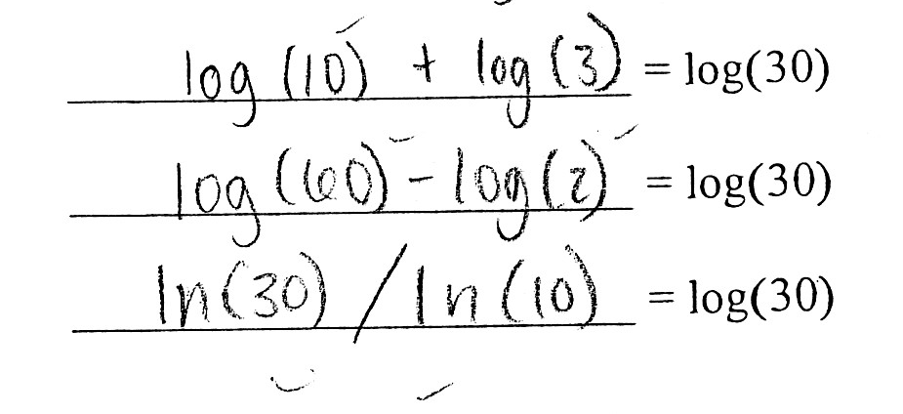
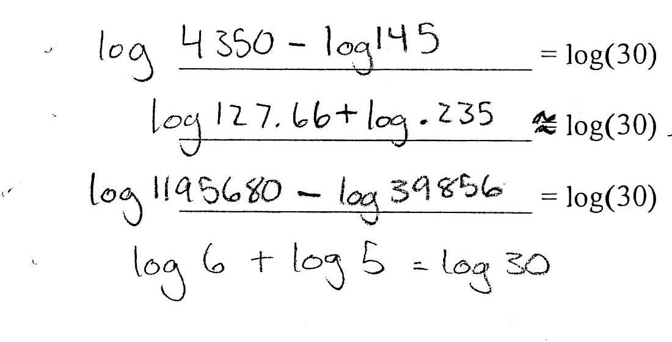
Use the properties of logarithms to write three different expressions equal to log(30). At least one should use a sum and one should use a difference.
Assessment

Slide 32
Final Exam Question: Alternate Solutions
In celebration of the end of the year, Eliza drop-kicks her backpack off of the atrium stairs after her last exam. The backpack’s initial height is 35 feet and she gives it an initial upward velocity of fourteen feet per second.
(part d) After how many seconds does the backpack hit the atrium floor with a most satisfying thud? Again, show your method and round to the nearest tenth of a second.
Assessment

Slide 33
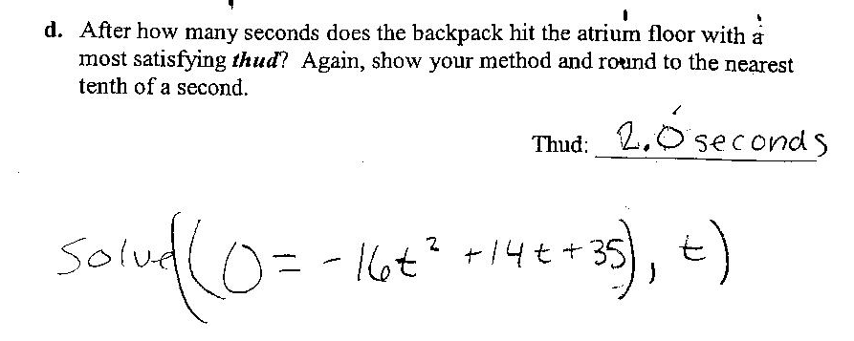
Solution #1
Assessment

Slide 34
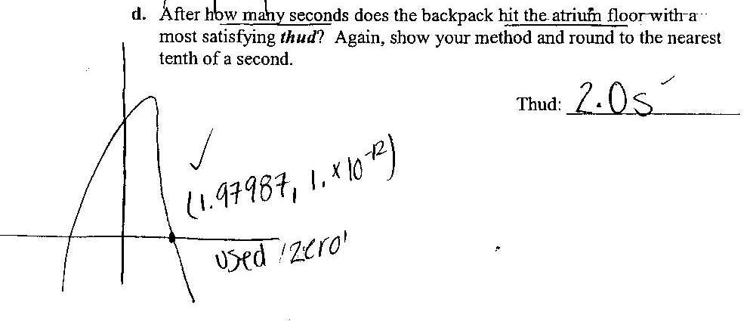
Solution #2
Assessment

Slide 35
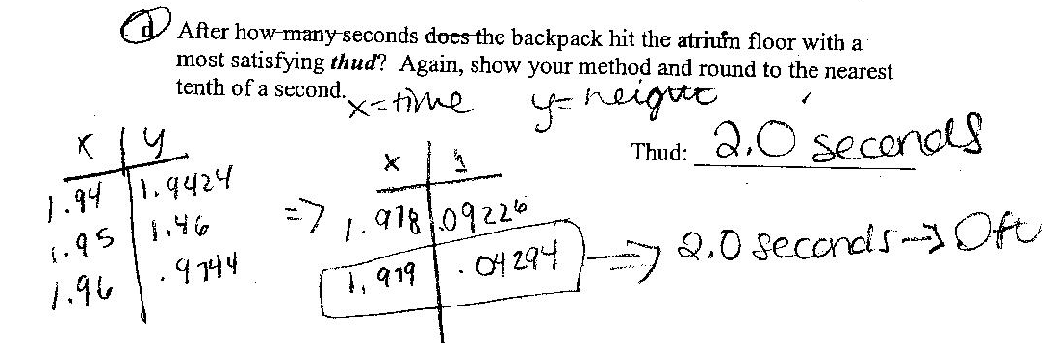
Solution #3
Assessment

Slide 36
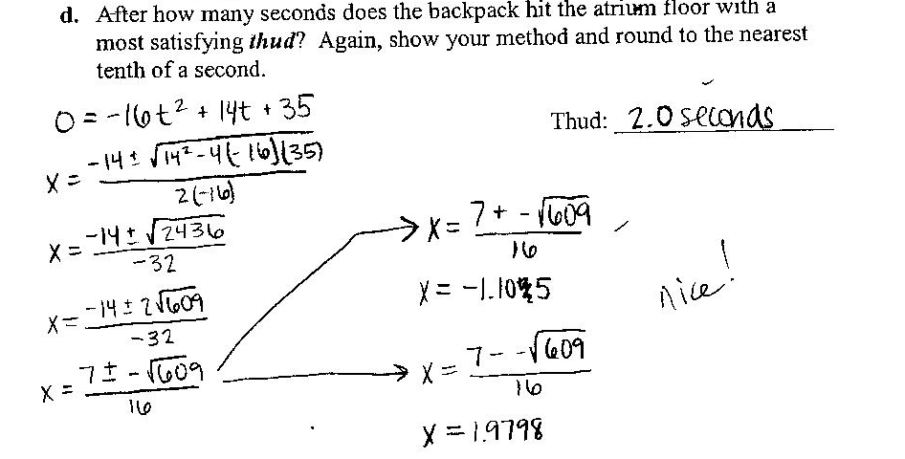
Solution #4
Assessment

Slide 37
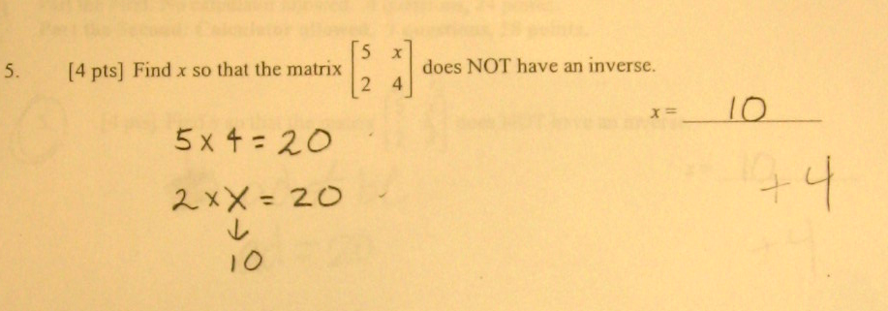
Alternate Solutions: Matrices
Find x so that the matrix does NOT have an inverse.
Assessment

Slide 38
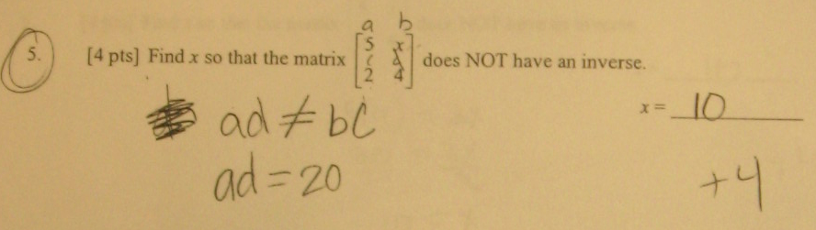
Alternate Solutions: Matrices
Find x so that the matrix does NOT have an inverse.
Assessment

Slide 39
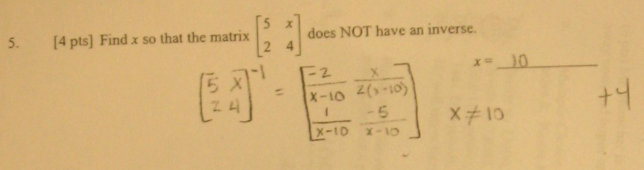
Alternate Solutions: Matrices
Find x so that the matrix does NOT have an inverse.
Assessment

Slide 40
Alternate Solution: Systems
Consider the system
(a) If b = -7, is the system consistent or inconsistent? Explain your answer.
(b) Find a positive value of b that makes the system consistent. Show your work.
Assessment

Slide 41
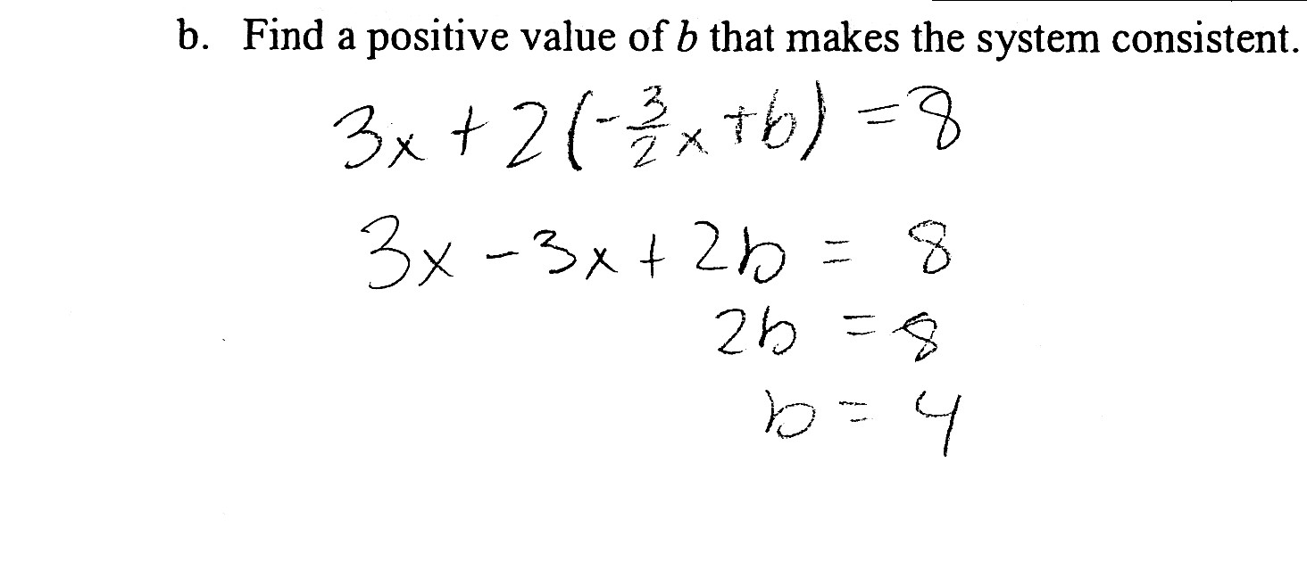
Alternate Solution: Systems
Assessment

Slide 42
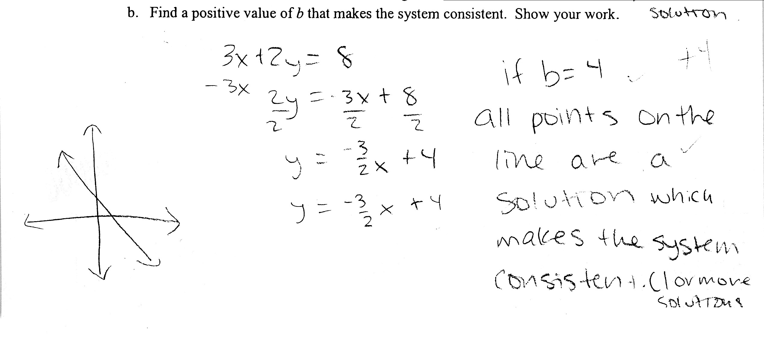
Alternate Solution: Systems
Assessment

Slide 43
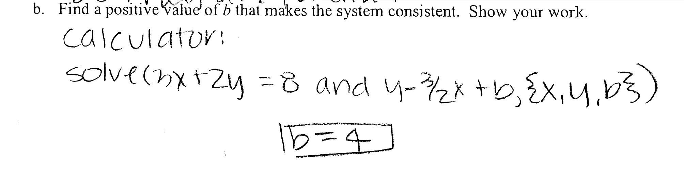

Alternate Solution: Systems
Assessment

Slide 44
CAS is Required
The algebra is too complicated
The symbolic manipulation gets in the way of comprehension
Assessment

Slide 45
CAS Required – Too Complicated
Consider the polynomial
  Sketch; label all intercepts.
  How many total zeros does f (x) have? _______
  How many of the zeros are real numbers? ______ Find them.
  How many of the zeros are NOT real numbers? ______ Find them.
Assessment

Slide 46
Symbolic Manipulation gets in the way
Solve for x and y:
Assessment
Swokowski and Cole, Precalculus: Functions and Graphs. Question #11, page 538

Slide 47
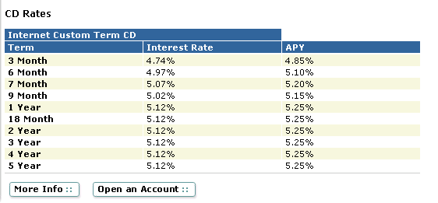
Variables in the Base AND in the Exponent
If a Certificate of Deposit pays 5.12% interest, which corresponds to an annual rate of 5.25%, how often is the interest compounded?
Assessment

Slide 48
Algebra 2 with CAS
Can be a stronger course
Can focus on flexibility rather than rote skills
Can be a lot of fun

Slide 49
Second Year Algebra with CAS
Michael Buescher
michael@mbuescher.com
Hathaway Brown School
Cleveland, Ohio
Teaching
Learning
Assessment
Lunch is in Regency A, Gold Level
11:15

